Slide 1
The Smugly Ignorant Grand Master
CAS Applied Data Science
14.06.2019
Marco Schaub

Slide 2
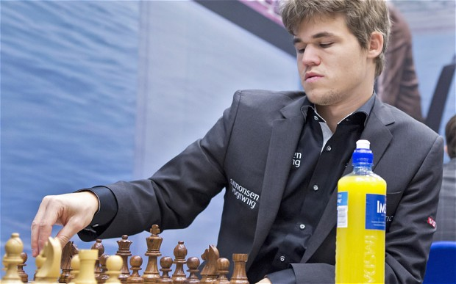
The Smugly Ignorant Grand Master (SIGMa)
Notes:
Picture of Magnus Carlsen, current world champion
The Smugly Ignorant Grand Master (SIGMa) is a program that without knowing anything about Chess can predict the winner of a game by simply looking at the board.

Slide 3
Get Training Data
Many datasets are available at Kaggle.com
Chess Game Dataset (Lichess) – 20,000 games
3.5 Million Chess Games
FICS Chess Games – 29,000 games
Chess Positions – 100,000 pictures of board positions
We pick the first one because of size (not too large) and because of the format
www.kaggle.com/datasnaek/chess
Notes:
FICS = Free Internet Chess Server

Slide 4
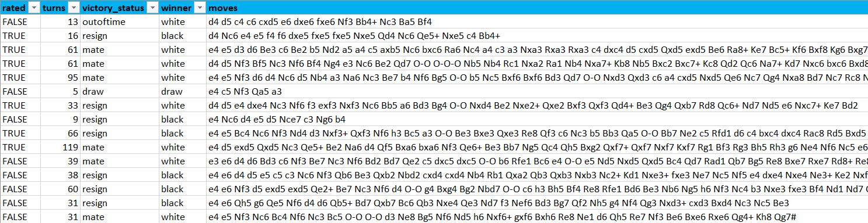
A Look at the Data

Slide 5
A First Challenge
The dataset uses Standard Algebraic Notation (SAN), which is a method for recording and describing the moves in Chess.
en.wikipedia.org/wiki/Algebraic_notation_(chess)
However, SIGMa judges a board by simply looking at it. So he makes use of something closer to the Forsyth–Edwards Notation (FEN), which is a standard notation for describing a particular board position in Chess
en.wikipedia.org/wiki/Forsyth-Edwards_Notation

Slide 6
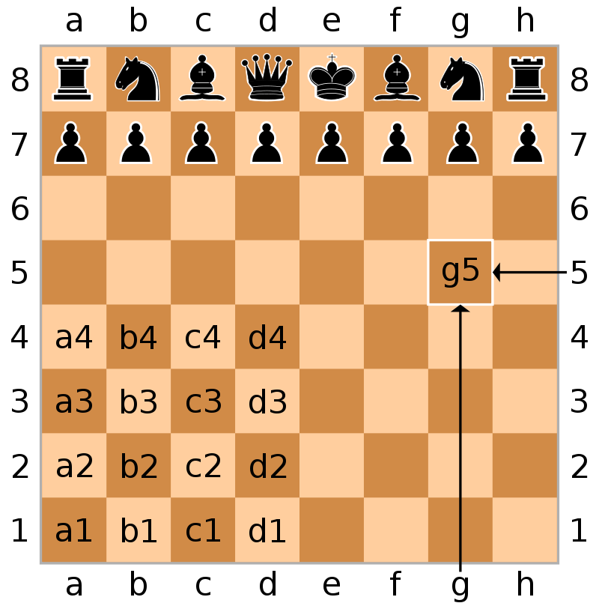
Standard Algebraic Notation (SAN)
Only moves are recorded
The language is highly abstracted
K – King
Q – Queen
R – Rook
B – Bishop
N – Knight
P - Pawn
x – Capture (e.g. «Bxd4»)
O – O / O – O – O – Castling
+ - Check
# - Checkmate
Notes:
«Rank» is from 1 to 8 (row)
«File» is from a to h (column)

Slide 7
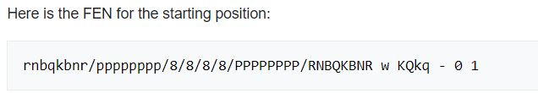
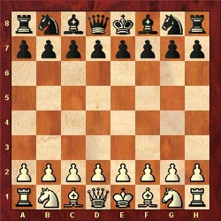
Forsyth–Edwards Notation (FEN)
First is the board position of all the pieces, going by rank
Black is lowercase, White is uppercase
Second is active player (w or b)
Third is castling availability
Fourth is en-passant traget square («-» if there is none)
Fifth is the halfmove clock
50-move rule
Sixth is the fullmove number
Notes:
50-Move Rule: https://en.wikipedia.org/wiki/Fifty-move_rule

Slide 8
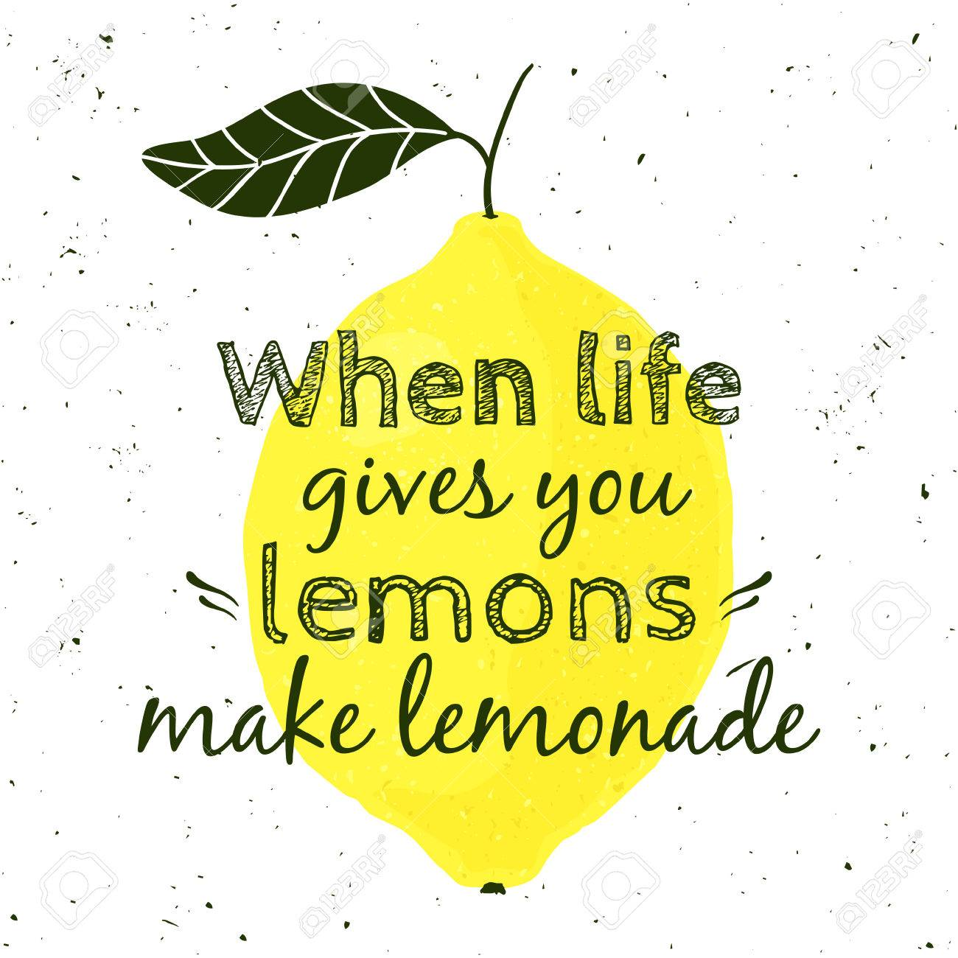
When Life Gives You Lemons …
The data describes moves, but we want board positions
Luckily, Python has a Chess module that understands the rules of Chess
… AND can produce board positions after every move
So this is a great way to get much more data!
From the 20,000 games in our dataset, we can generate 1,200,000 board positions, roughly 60 times more training data

Slide 9
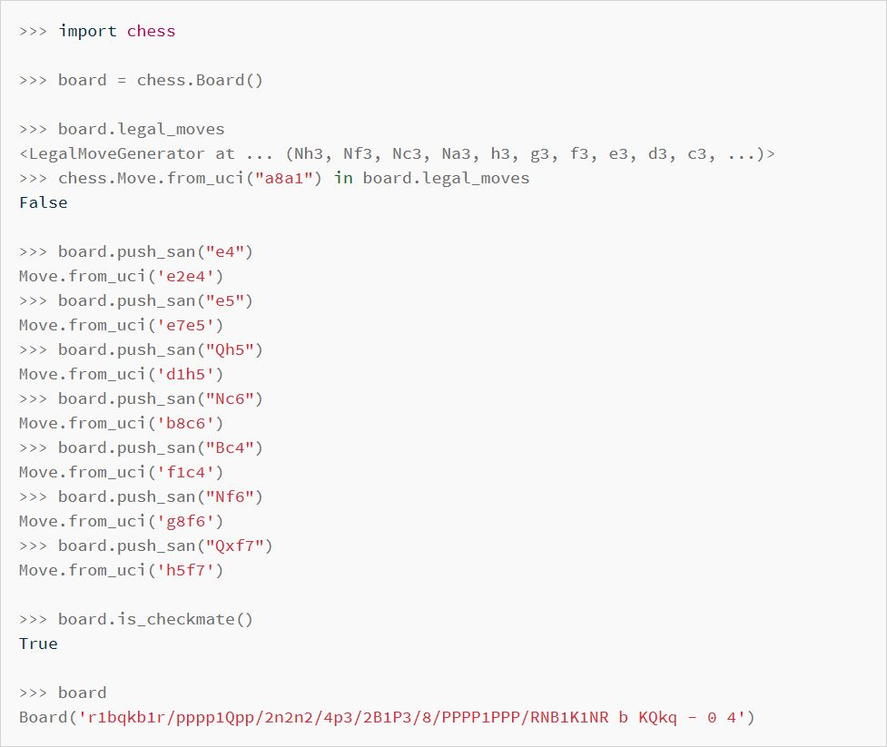
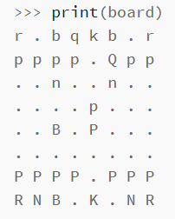
The Python Chess Library
Notes:
https://pypi.org/project/python-chess
Install in PowerShell with the command: “python -m pip install python-chess”

Slide 10
Next Steps
After training on the Lichess dataset, SIGMa should be able to predict the outcome of a game just by taking into account the position
After doing so, the tool could be improved in such a way that it could predict the outcome of the the Chess Positions dataset, which has 100,000 pictures of (digital) Chess boards
Lastly, the tool could be improved to recognizing actual 3D board positions, so you could walk up to a board and make a guess

Slide 11
Questions And Challenges
Should the full FEN notation be used to train the model?
Yes, because more information is better
No, because the information is not of the same kind and could confuse
No, because we want to simulate walking up to a board
Should the board information be transcribed into a 64-array?
Should the network be trained such that we only take the state after full moves?
Yes, because it’s easier and we don’t need a 65th array element
No, because this would make it less useful in the end
No, because this information is not always available

